Slide 1

JSS Academy of Technical Education, Bangalore-60
DEPARTMENT OF ISE
Arrays
Under the guidance of
Mrs. K.S Rajeshwari
Associate Professor
Department of Computer Science Engineering
JSS Academy of Technical Education, Bangalore-60
Group8:
Vishal KT
Sreeranga J
Pratham T
Nitin Hegde

Slide 2
Acknowledgement
Special thanks to our beloved Principal Dr.Mrithyunjaya V Latte for their able guidance and support for completing our project.
We are grateful to our teachers and professors who gave us a chance to work on this project. We would like to express our special thanks of gratitude to our CPS [C programming for Problem Solving] teacher Rajeshwari Ma’am, to our HOD Rekha Ma’am for their able guidance and support for completing our project.

Slide 3
TABLE OF CONTENTS
Contents | Pg.no
Introduction to Arrays | 3
Selection of Real-Life Problem | 18
Output of the program | 19
Applications of Array | 22
Conclusion | 24
References | 25

Slide 4
INTRODUCTION TO ARRAYS
An array is a collection of items stored at contiguous memory locations. The idea is to store multiple items of the same type together.
Arrays allow random access to elements. This makes accessing elements by position faster.

Slide 5
Types of indexing in an array:\
0 / (zero-based indexing): The first element of the array is indexed by a subscript of 0.
1 / (one-based indexing): The first element of the array is indexed by the subscript of 1.
n / (n-based indexing): The base index of an array can be freely chosen. Usually, programming languages allowing n-based indexing also allow negative index value .

Slide 6
The dimension of an array is the number of indices needed to select an element.
A one-dimensional array (or single dimension array) is a type of linear array. Accessing its elements involves a single subscript which can either represent a row or column index.
Two indices are used for a two-dimensional array, three for a three-dimensional array, and n for an n-dimensional array.

Slide 7
Array has a fixed size meaning once the size is given to it, it cannot be changed i.e., you can’t shrink it neither can you expand it.
If we expand the size of array, which is not possible every time, we can’t be sure that we get the next memory location to us as free. The shrinking will not work because the array, when declared, gets memory statically allocated, and thus compiler is the only one can destroy it.

Slide 8
Declaration of one dimensional arrays:
A one dimensional array can be declared using the following syntax:
data_type array_name[array_size];
Where data_type can be int,float or char.
Array_name is name of the array which has taken by following the rules of identifier.
Array_size indicates number of elements in the array which is always a positive number.
Ex: int age[5]; float mynum[50];

Slide 9
Declaration of TWO dimensional arrays:
A two dimensional array can be declared using the following syntax:
data_type array_name[row_size][column_size];
Where data_type can be int,float or char.
Array_name is name of the array which has taken by following the rules of identifier.
row_size indicates number of rows in the 2D array
column_size indicates number of columns in 2D array
Ex: char name[10][10]; int cps_marks[2][60];

Slide 10
Initialization of array:
The values can be stored in array using following methods:
1. Initializing all specified memory locations(compile time initialization).
2. Initializing individual elements(compile time initialization).
3. Partial array initialization.
4.Intialization during program execution(Run time initialization).

Slide 11
Reading and writing one dimensional array
We use for loop in both reading case and writing case.
Ex:To store age of 5 students
Int age[5];
Reading(input) :
for(i=0;i<5;i++)
scanf(“%d”,&age[i]);
Writing(output):
for(i=0;i<5;i++)
printf(“%d”,age[i]);

Slide 12
Reading and writing TWO dimensional array
We use 2 for loops in both reading case and writing case.
Ex:To store cps marks of 2 classes of 60 students
Int cps_marks[2][60];
Reading (input):
for(i=0;i<2;i++)
for(j=0;j<60;j++)
scanf(“%d”,& cps_marks[i][j]);

Slide 13
Writing(output):
for(i=0;i<2;i++)
for(j=0;j<60;j++)
printf(“%d\t”, cps_marks[i][j]);
printf(“%n”);

Slide 14
Actions that can be performed on arrays

Slide 15
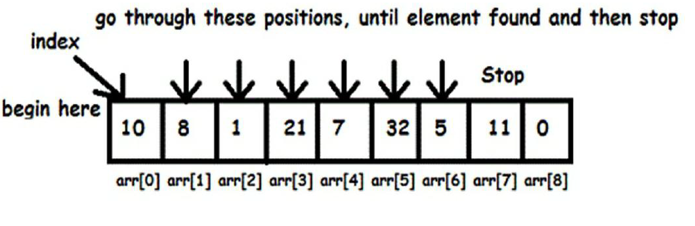

Linear search
Linear search is a very simple search algorithm.
In this type of search, a sequential search is made over all items one by one.
Every item is checked and if a match is found then that particular item is returned, otherwise the search continues till the end of the data collection.
Here is simple approach is to do linear search:

Slide 16
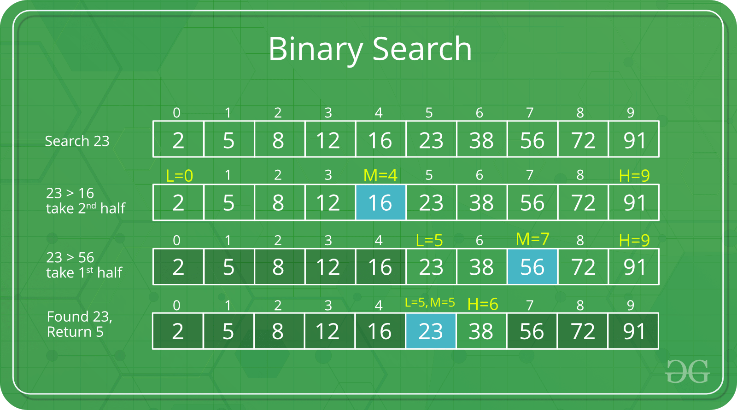
Binary search
Search a sorted array by repeatedly dividing the search interval into half.
Begin with an interval covering the whole array. If the value of the search key is less than the item in the middle of the interval, narrow the interval to the lower half.
Otherwise narrow it to the upper half.
Repeatedly check until the value is found or the interval is empty.

Slide 17
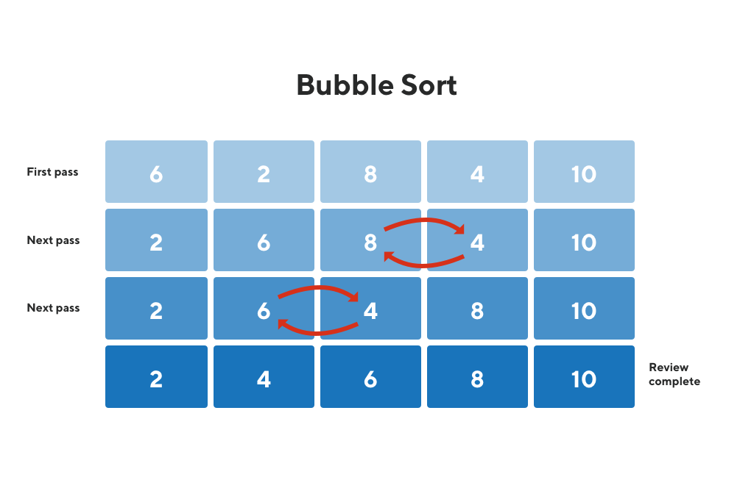
Bubble sort
Bubble sort is a simple algorithm which is used to sort a given set of n-elements provided in form of array with n number of elements.
Bubble sort compares the entire element one by one and sort them based on their values.
If the given array has to be sorted in ascending order, then bubble sort will start by comparing the first element of the array with the second element , if the first element is grater than the second element , it will swap both the elements, and then move on to compare the second and the third element and so on.

Slide 18
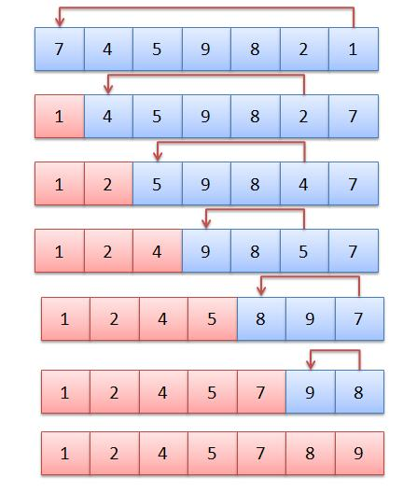
Selection sort
Selection sort is conceptually the simplest sorting algorithm.
This algorithm will find the smallest element in the array and swap it with the element in the first position , then it will find the second smallest element and swap it with the element in the second position , and it will keep on doing this until the entire array is sorted.
It is called selection sort because it repeatedly selects the next-smallest element and swaps it into the right place.

Slide 19
SELECTION OF PROBLEM BASED ON TOPIC CHOOSEN
The Real-Life Problem Chosen is Matrix Calculator. Calculator in the present-day life is used everywhere. There are many types of calculators based on the need of the user.
Matrix Calculator is a Calculator which is used only for doing Matrix mathematical Calculations such as Sum of 2 Matrices, To find Determinant of a Square Matrix, To find Inverse of a Square Matrix etc.
The calculators present in real life are not capable of doing matrix computations such as determinant of matrix or adjoint of a matrix or inverse of matrix, so this calculator coded can be used to do such computations by pre university or university students while doing mathematical matrix calculations

Slide 20
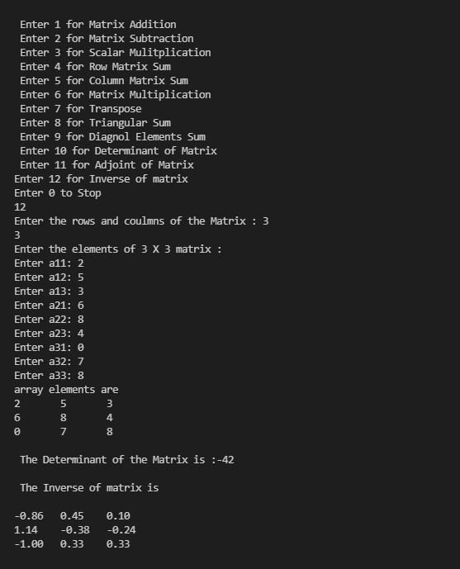
Output snaps

Slide 21
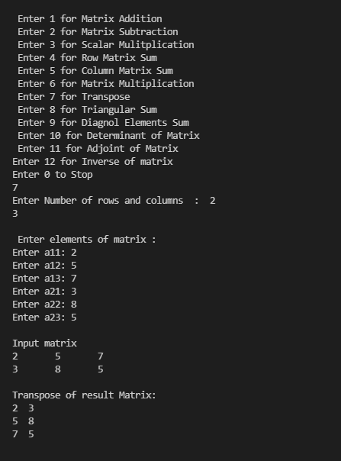

Slide 22
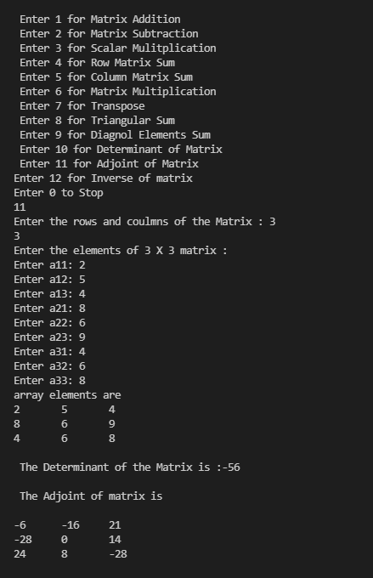

Slide 23
Applications of Arrays:
Arrays are used to implement mathematical vectors and matrices, as well as other kinds of rectangular tables. Many databases, small and large, consist of (or include) one-dimensional arrays whose elements are records.
It is used in Photography, Report making, Pixel management
It is been used in rapidly growing A.I technology and Cloud Computing & Cloud Storage of immense data on a day-to-day basis
It is basically a playground for further discoveries and experimentation

Slide 24
It can also be used in :
Encryption In encryption, we use it to scramble data for security purposes to encode and to decode this data we need matrices. There is a key that helps encode and decode data which is generated by matrices.
Games especially 3D They use it to alter the object, in 3d space. They use the 3d matrix to 2d matrix to convert it into the different objects as per requirement.
Economics and business To study the trends of a business, shares, and more. To create business models etc

Slide 25
Conclusion
We have successfully presented the Arrays topic in the most leisure language Arrays are mainly used to store multiple values in a single variable by assigning size and name, since it cannot be done using a single variable otherwise. Arrays can be used in our daily lives. It can be predominantly found in Maths as there is a separate branch dedicated to it.
The source code solves the real-life problem of present-day calculators not capable of doing advanced matrix manipulations using the concepts of arrays and functions (reducing the size of the code).

Slide 26
REFERENCES:
Programming in ANSI C – (E.Balaguruswami)
https://www.wikipedia.org/

Slide 27
THANK YOU.

